Slide 1
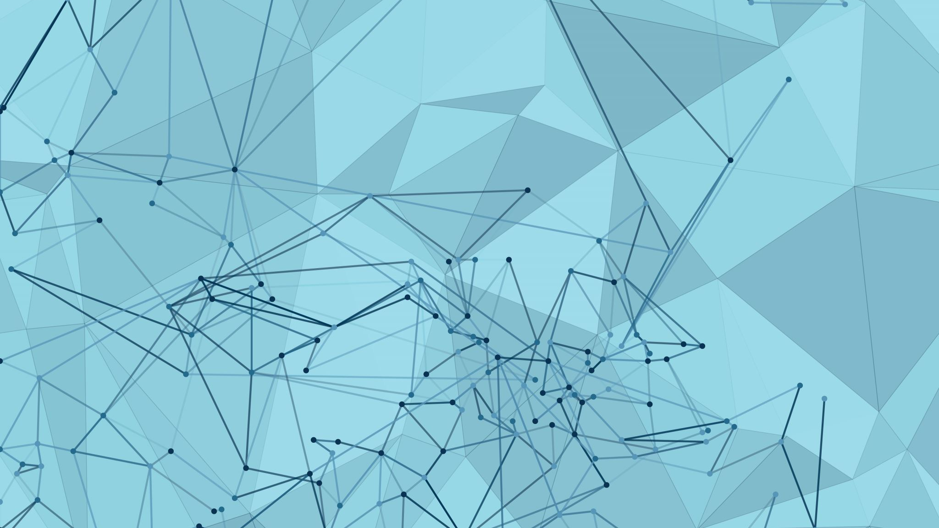
Custom OCR Using YOLOv3 & Tesseract

Slide 2
Project Overview
Combine YOLOv3 and Tesseract for OCR
Extract editable text from lab reports
Implemented in Google Colab using Google Cloud OCR

Slide 3
Objectives
Detect text regions with YOLOv3
Enhance image clarity via preprocessing
Extract text with Tesseract
Save extracted data in CSV format

Slide 4
Tools & Technologies
Python, Google Colab
YOLOv3, Tesseract OCR
OpenCV, Matplotlib
CSV Modul

Slide 5
Folder Structure
model/: YOLO weights, config, names
ocrimages/: Input images
output1.csv: Extracted text
main.py: Core script

Slide 6
Setup Instructions
Mount Google Drive
Install libraries: OpenCV, Tesseract
Download YOLOv3 weights and config

Slide 7
Execution Steps
Image Preprocessing: Resize, grayscale, blur, threshold
Text Extraction: Preprocessed image -> Tesseract -> Text
Data Storage: Save extracted text to CSV

Slide 8
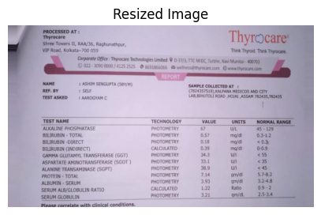
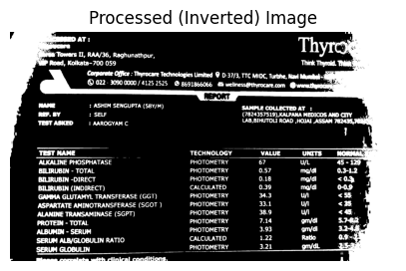
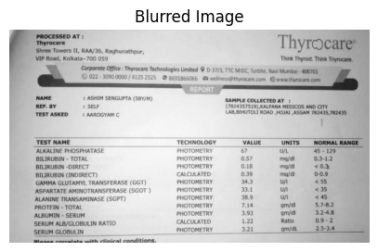
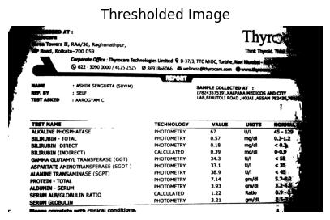

Slide 9
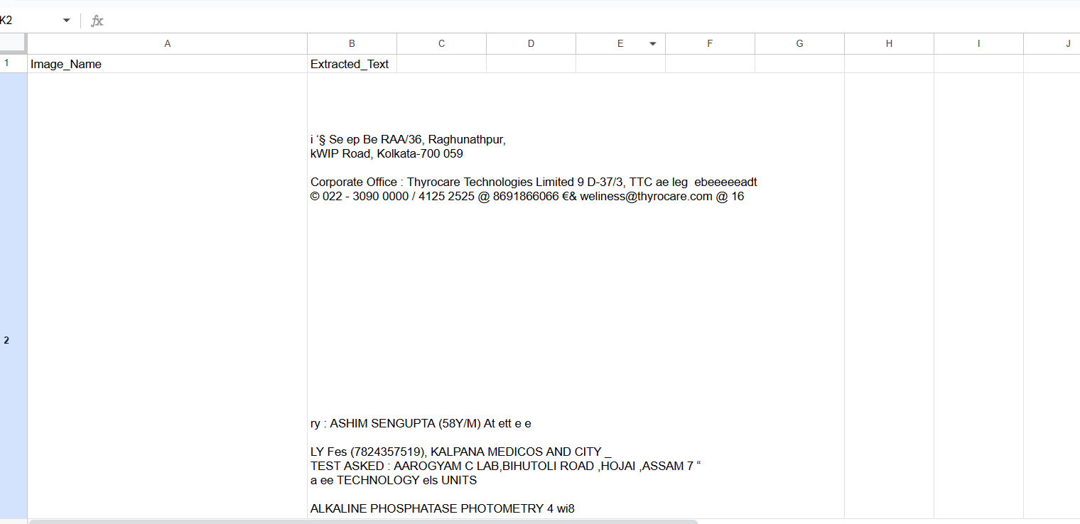
Key Functions
preprocess_image(): Preps image for OCR
extract_text(): Extracts text from image
save_to_csv(): Stores results in CSV

